Slide 1
Final Flash Review

Slide 2
Final Possible Topics
SCM II bullwhip effect + knowledge sharing + Danone
SCM III quick response + Obermeyer + contracts
Queue I little’s law + variability + utilization
Queue II waiting time + throughput losses
Queue III pooling + psychology of queueing
Strategy I protection levels + overbooking
Strategy II product management + design thinking + IDEO
Emerging transparency + e-commerce + future of work Tessei Amazon Google
Process process analysis + inventory buildup (seasonality)
Inventory newsvendor + risk-pooling

Slide 3

SCM – 0.07
When products are rationed, retailers often respond by placing ___________ (= inflated orders)
1:00
0:59
0:58
0:57
0:56
0:55
0:54
0:53
0:52
0:51
0:50
0:49
0:48
0:47
0:46
0:45
0:44
0:43
0:42
0:41
0:40
0:39
0:38
0:37
0:36
0:35
0:34
0:33
0:32
0:31
0:30
0:29
0:28
0:27
0:26
0:25
0:24
0:23
0:22
0:21
0:20
0:19
0:18
0:17
0:16
0:15
0:14
0:13
0:12
0:11
0:10
0:09
0:08
0:07
0:06
0:05
0:04
0:03
0:02
0:01
End
0:20
Answer:

Slide 4
SCM – 0.07
Phantom orders
This is called shortage gaming, one of the causes of the bullwhip effect
Back to the board

Slide 5
SCM – 0.09
R = retailer, M = manufacturer
Optimal buy-back price is computed by matching…
R’s price and M’s cost
R’s gains and SC’s gains
R’s critical ratio and M’s critical ratio
R’s z* and SC’s z*
1:00
Answer:
0:59
0:58
0:57
0:56
0:55
0:54
0:53
0:52
0:51
0:50
0:49
0:48
0:47
0:46
0:45
0:44
0:43
0:42
0:41
0:40
0:39
0:38
0:37
0:36
0:35
0:34
0:33
0:32
0:31
0:30
0:29
0:28
0:27
0:26
0:25
0:24
0:23
0:22
0:21
0:20
0:19
0:18
0:17
0:16
0:15
0:14
0:13
0:12
0:11
0:10
0:09
0:08
0:07
0:06
0:05
0:04
0:03
0:02
0:01
End
0:20

Slide 6
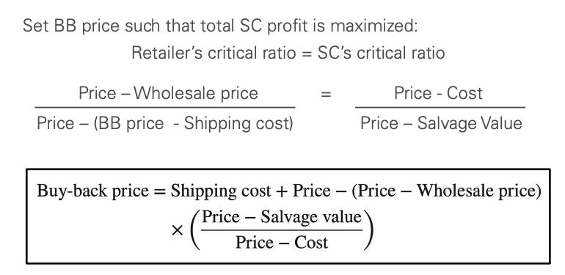
SCM – 0.09
D. R’s z* and SC’s Z*
Back to the board

Slide 7
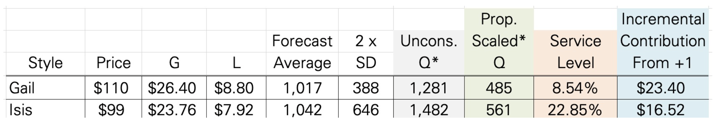
SCM – 0.12
When capacity is not enough to make all proportionally scaled quantities, then…
Scale down both quantities proportionally
Do more Gail, less Isis
Do more Isis, less Gail
1:00
Answer:
0:59
0:58
0:57
0:56
0:55
0:54
0:53
0:52
0:51
0:50
0:49
0:48
0:47
0:46
0:45
0:44
0:43
0:42
0:41
0:40
0:39
0:38
0:37
0:36
0:35
0:34
0:33
0:32
0:31
0:30
0:29
0:28
0:27
0:26
0:25
0:24
0:23
0:22
0:21
0:20
0:19
0:18
0:17
0:16
0:15
0:14
0:13
0:12
0:11
0:10
0:09
0:08
0:07
0:06
0:05
0:04
0:03
0:02
0:01
End
0:20

Slide 8
SCM – 0.12
B. Do more Gail, less Isis
Gail has higher IC, more profitable to make more of them
Back to the board

Slide 9



SCM – 0.15
By owning both Ray-Ban and Sunglass Hut, Luxottica can avoid the problem of ______________
1:00
Answer:
0:59
0:58
0:57
0:56
0:55
0:54
0:53
0:52
0:51
0:50
0:49
0:48
0:47
0:46
0:45
0:44
0:43
0:42
0:41
0:40
0:39
0:38
0:37
0:36
0:35
0:34
0:33
0:32
0:31
0:30
0:29
0:28
0:27
0:26
0:25
0:24
0:23
0:22
0:21
0:20
0:19
0:18
0:17
0:16
0:15
0:14
0:13
0:12
0:11
0:10
0:09
0:08
0:07
0:06
0:05
0:04
0:03
0:02
0:01
End
0:30

Slide 10
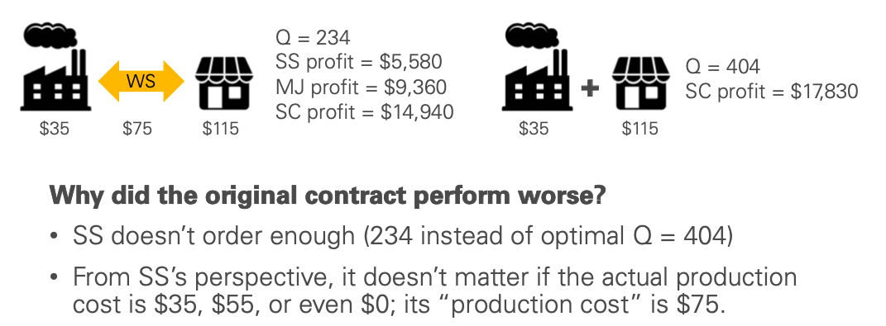
SCM – 0.15
Double Marginalization
Back to the board

Slide 11
SCM – 0.17
Obermeyer: Haas Style, price = $100 Gain 32% price, loss 8% price
Can order from China first, HK as reactive later ($12/unit premium)
If China’s Q is ordered optimally, what is the service level for the China order (in %)?
Answer:
1:00
0:59
0:58
0:57
0:56
0:55
0:54
0:53
0:52
0:51
0:50
0:49
0:48
0:47
0:46
0:45
0:44
0:43
0:42
0:41
0:40
0:39
0:38
0:37
0:36
0:35
0:34
0:33
0:32
0:31
0:30
0:29
0:28
0:27
0:26
0:25
0:24
0:23
0:22
0:21
0:20
0:19
0:18
0:17
0:16
0:15
0:14
0:13
0:12
0:11
0:10
0:09
0:08
0:07
0:06
0:05
0:04
0:03
0:02
0:01
End
1:00

Slide 12
SCM – 0.17
60%
Gain (China) = $12 (HK premium) Loss is still 8% x $100 = $8
Critical Ratio = $12/$20 = 0.6
= Service Level
Back to the board

Slide 13
Queue – 0.07
Fraction of servers who are busy serving customers on average = ______________
1:00
0:59
0:58
0:57
0:56
0:55
0:54
0:53
0:52
0:51
0:50
0:49
0:48
0:47
0:46
0:45
0:44
0:43
0:42
0:41
0:40
0:39
0:38
0:37
0:36
0:35
0:34
0:33
0:32
0:31
0:30
0:29
0:28
0:27
0:26
0:25
0:24
0:23
0:22
0:21
0:20
0:19
0:18
0:17
0:16
0:15
0:14
0:13
0:12
0:11
0:10
0:09
0:08
0:07
0:06
0:05
0:04
0:03
0:02
0:01
End
0:20
Answer:

Slide 14
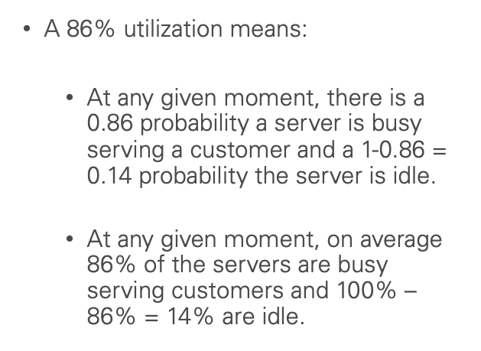
Queue – 0.07
Utilization
Back to the board

Slide 15
Queue – 0.09
What is not the benefit of pooling queues?: Reducing…
time in queue
flow time
# customers in queue
# customers in service
1:00
Answer:
0:59
0:58
0:57
0:56
0:55
0:54
0:53
0:52
0:51
0:50
0:49
0:48
0:47
0:46
0:45
0:44
0:43
0:42
0:41
0:40
0:39
0:38
0:37
0:36
0:35
0:34
0:33
0:32
0:31
0:30
0:29
0:28
0:27
0:26
0:25
0:24
0:23
0:22
0:21
0:20
0:19
0:18
0:17
0:16
0:15
0:14
0:13
0:12
0:11
0:10
0:09
0:08
0:07
0:06
0:05
0:04
0:03
0:02
0:01
End
0:20

Slide 16
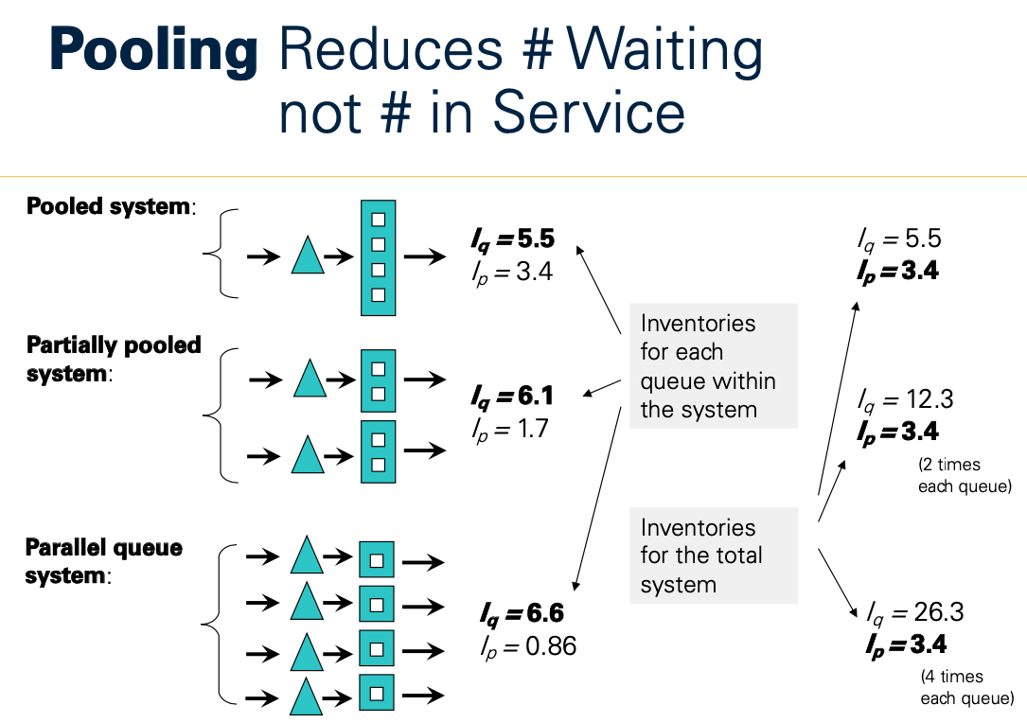
Queue – 0.09
D. # in service
Back to the board

Slide 17
Queue – 0.12
Which is incorrect use of Little’s Law?
R = # Amazon employees quitting every year
R = Cost of Goods Sold (COGS) at CVS
T = average tenure of Google employees
R/I = How often Walmart replenishes inventory
1:00
Answer:
0:59
0:58
0:57
0:56
0:55
0:54
0:53
0:52
0:51
0:50
0:49
0:48
0:47
0:46
0:45
0:44
0:43
0:42
0:41
0:40
0:39
0:38
0:37
0:36
0:35
0:34
0:33
0:32
0:31
0:30
0:29
0:28
0:27
0:26
0:25
0:24
0:23
0:22
0:21
0:20
0:19
0:18
0:17
0:16
0:15
0:14
0:13
0:12
0:11
0:10
0:09
0:08
0:07
0:06
0:05
0:04
0:03
0:02
0:01
End
0:30

Slide 18
Queue – 0.12
C. Average tenure
for any employee is not T
T = average tenure “at departure”
Back to the board

Slide 19
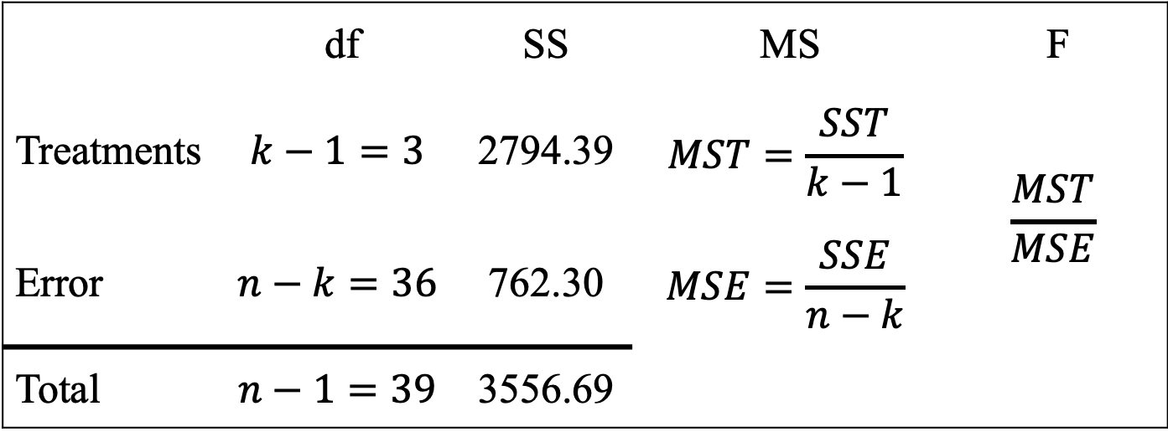
Queue – 0.15
One server. Mean interarrival time is a. Mean service time is p < a.
Mean # of customers in system is I. Mean # of customers waiting is I_{q}
Which is correct?
A. I = (a/p) + I_{q}
B. I = (p/a) + I_{q}
C. I = (a/p) x I_{q}
D. I = (p/a) x I_{q}
1:00
Answer:
0:59
0:58
0:57
0:56
0:55
0:54
0:53
0:52
0:51
0:50
0:49
0:48
0:47
0:46
0:45
0:44
0:43
0:42
0:41
0:40
0:39
0:38
0:37
0:36
0:35
0:34
0:33
0:32
0:31
0:30
0:29
0:28
0:27
0:26
0:25
0:24
0:23
0:22
0:21
0:20
0:19
0:18
0:17
0:16
0:15
0:14
0:13
0:12
0:11
0:10
0:09
0:08
0:07
0:06
0:05
0:04
0:03
0:02
0:01
End
0:45

Slide 20
Queue – 0.15
B.
# customers in service = p/a
(Little’s Law)
# total = I = p/a + I_{q}
Back to the board

Slide 21

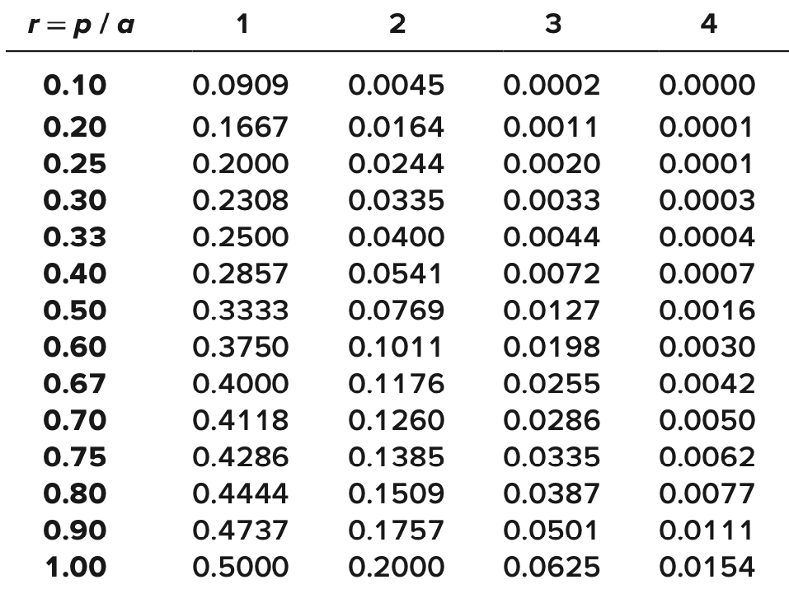
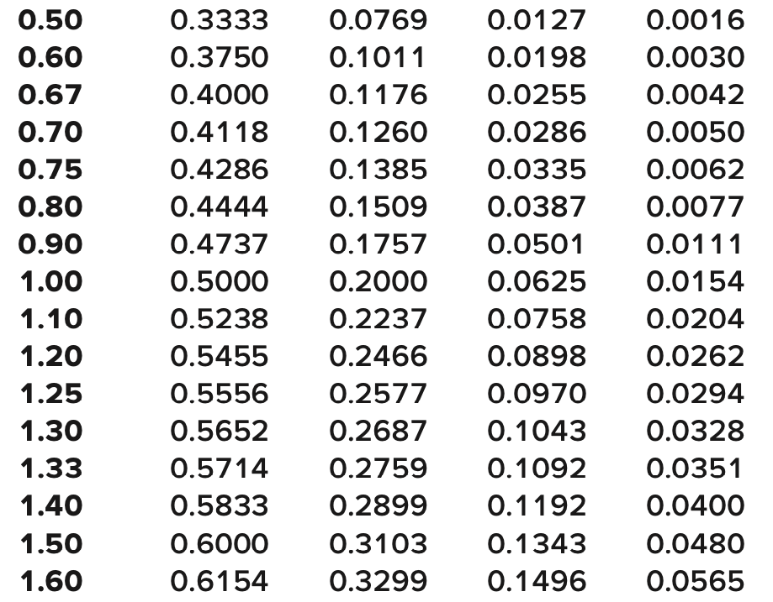
Queue – 0.17
m
4 trauma bays
99.5% incoming ambulance will be accepted currently.
What is the bays’ utilization (%)?
1:00
Answer:
0:59
0:58
0:57
0:56
0:55
0:54
0:53
0:52
0:51
0:50
0:49
0:48
0:47
0:46
0:45
0:44
0:43
0:42
0:41
0:40
0:39
0:38
0:37
0:36
0:35
0:34
0:33
0:32
0:31
0:30
0:29
0:28
0:27
0:26
0:25
0:24
0:23
0:22
0:21
0:20
0:19
0:18
0:17
0:16
0:15
0:14
0:13
0:12
0:11
0:10
0:09
0:08
0:07
0:06
0:05
0:04
0:03
0:02
0:01
End
1:00

Slide 22
Queue – 0.17
17.5%
P(4 bays busy) = 0.5%
r = p/a = 0.7
Utilization = p/ma
= r/m = 0.7/4
= 0.175
Back to the board

Slide 23
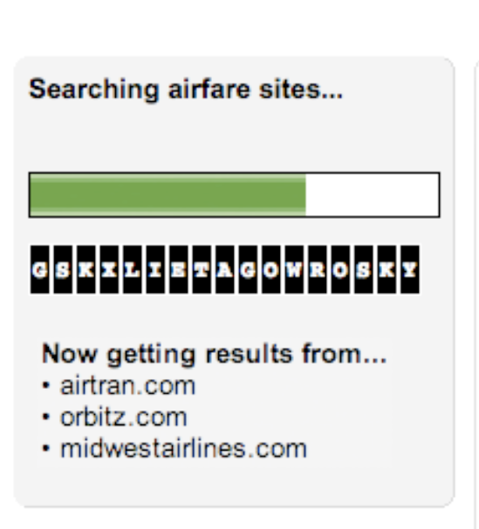
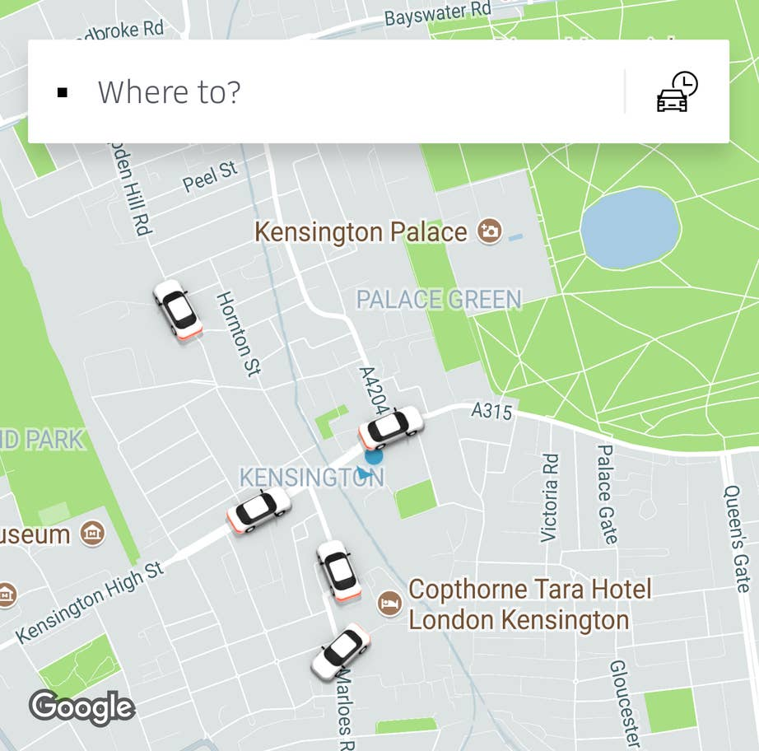
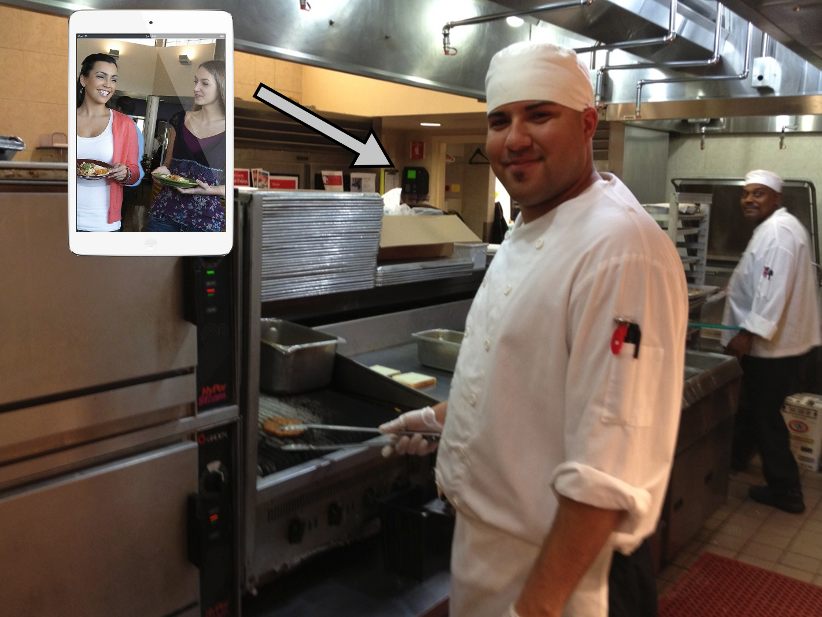
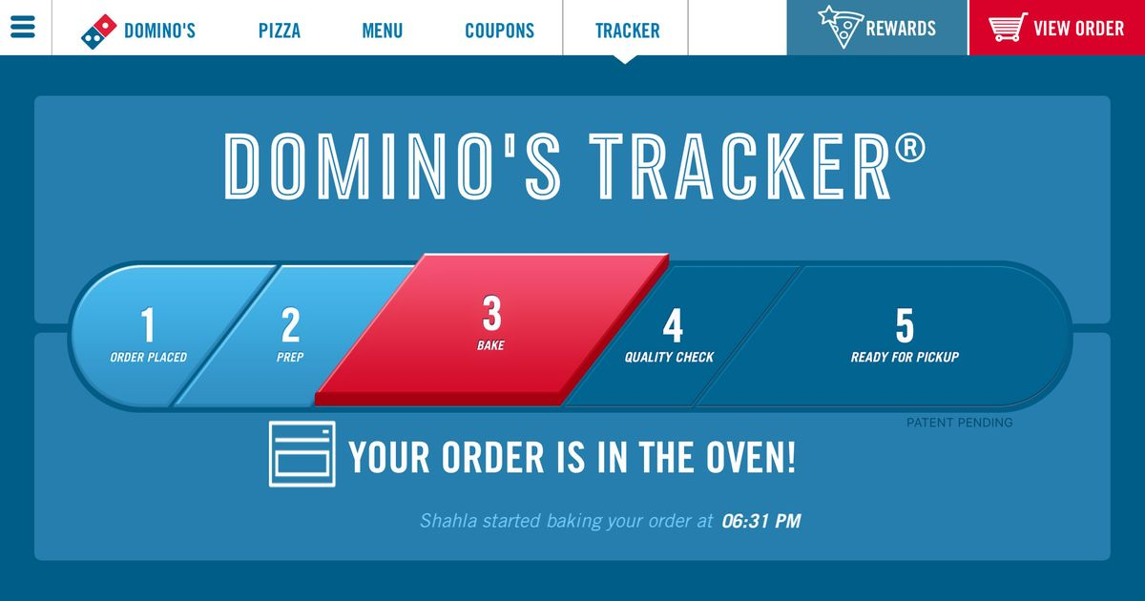
Emerging – 0.07
Which transparency is different from the rest?
C
A
B
D
1:00
0:59
0:58
0:57
0:56
0:55
0:54
0:53
0:52
0:51
0:50
0:49
0:48
0:47
0:46
0:45
0:44
0:43
0:42
0:41
0:40
0:39
0:38
0:37
0:36
0:35
0:34
0:33
0:32
0:31
0:30
0:29
0:28
0:27
0:26
0:25
0:24
0:23
0:22
0:21
0:20
0:19
0:18
0:17
0:16
0:15
0:14
0:13
0:12
0:11
0:10
0:09
0:08
0:07
0:06
0:05
0:04
0:03
0:02
0:01
End
0:20
Answer:

Slide 24
Emerging – 0.07
C = Customer Transparency
The others are process transparency
Back to the board

Slide 25
Emerging – 0.09
What is not how Tessei addressed their challenges?
Cleaners interact with riders at station (“water painting on the floor”)
Cleaners accept trash directly from riders
Cleaners wear Hawaiian shirts in summer
Drop their mission of train cleaning entirely
1:00
Answer:
0:59
0:58
0:57
0:56
0:55
0:54
0:53
0:52
0:51
0:50
0:49
0:48
0:47
0:46
0:45
0:44
0:43
0:42
0:41
0:40
0:39
0:38
0:37
0:36
0:35
0:34
0:33
0:32
0:31
0:30
0:29
0:28
0:27
0:26
0:25
0:24
0:23
0:22
0:21
0:20
0:19
0:18
0:17
0:16
0:15
0:14
0:13
0:12
0:11
0:10
0:09
0:08
0:07
0:06
0:05
0:04
0:03
0:02
0:01
End
0:20

Slide 26
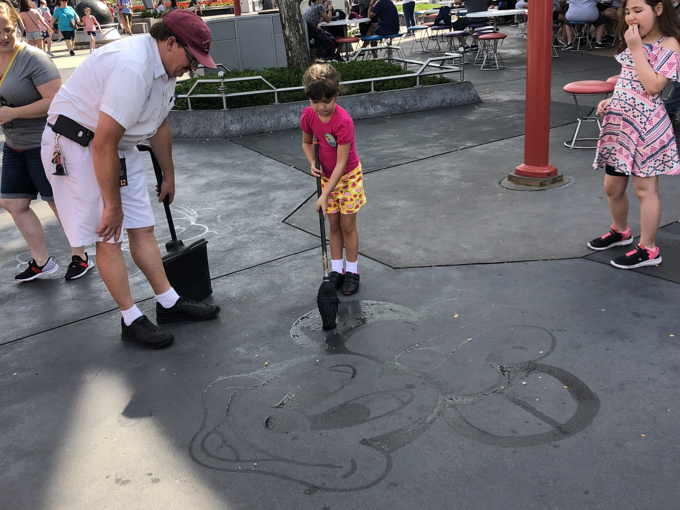
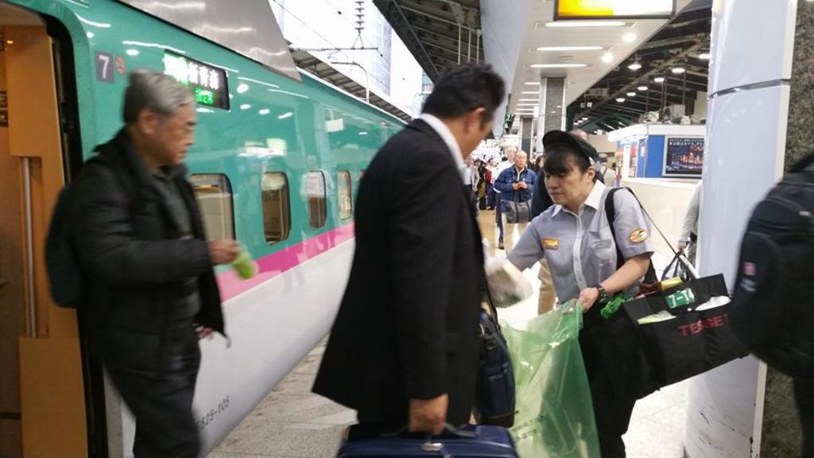
Emerging – 0.09
A. Water Painting
(That was Disneyland!)
Back to the board

Slide 27
Emerging – 0.12
Knowledge spillovers from Google TVCs are…
Positive
Negative
Both
1:00
Answer:
0:59
0:58
0:57
0:56
0:55
0:54
0:53
0:52
0:51
0:50
0:49
0:48
0:47
0:46
0:45
0:44
0:43
0:42
0:41
0:40
0:39
0:38
0:37
0:36
0:35
0:34
0:33
0:32
0:31
0:30
0:29
0:28
0:27
0:26
0:25
0:24
0:23
0:22
0:21
0:20
0:19
0:18
0:17
0:16
0:15
0:14
0:13
0:12
0:11
0:10
0:09
0:08
0:07
0:06
0:05
0:04
0:03
0:02
0:01
End
0:20

Slide 28
Emerging – 0.12
Both!
Positive: Get insider knowledge about other companies
Negative: They’ll tell others about Google, too!
Back to the board

Slide 29
Emerging – 0.15
Things that are economical to sell on e-commerce but not so much for brick-and-mortar retailer are _________________
1:00
Answer:
0:59
0:58
0:57
0:56
0:55
0:54
0:53
0:52
0:51
0:50
0:49
0:48
0:47
0:46
0:45
0:44
0:43
0:42
0:41
0:40
0:39
0:38
0:37
0:36
0:35
0:34
0:33
0:32
0:31
0:30
0:29
0:28
0:27
0:26
0:25
0:24
0:23
0:22
0:21
0:20
0:19
0:18
0:17
0:16
0:15
0:14
0:13
0:12
0:11
0:10
0:09
0:08
0:07
0:06
0:05
0:04
0:03
0:02
0:01
End
0:30

Slide 30
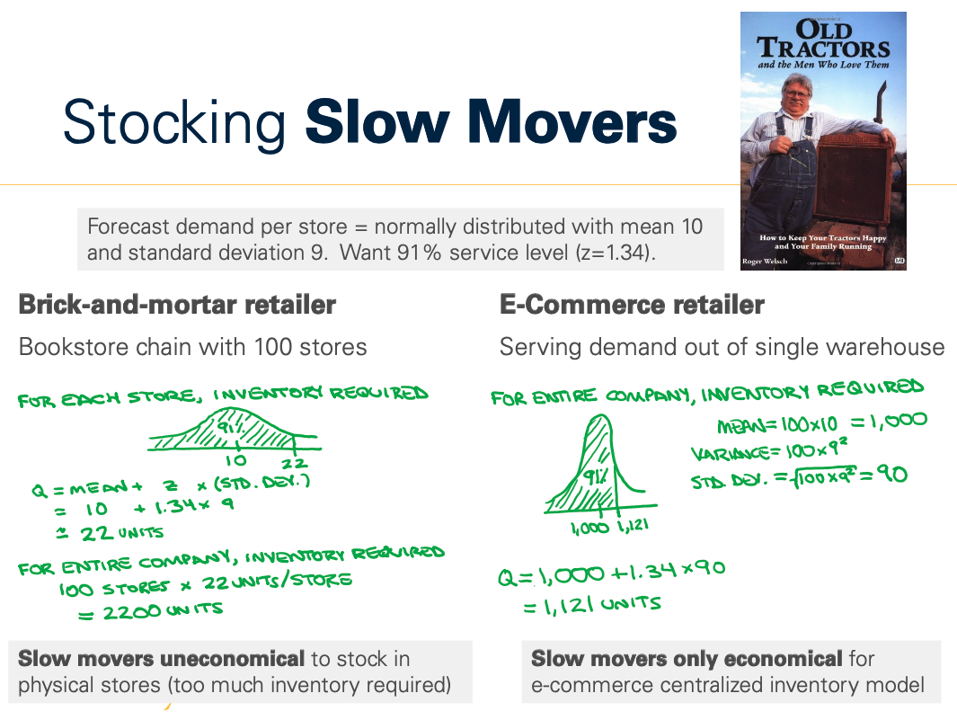
Emerging – 0.15
Slow Movers
Back to the board

Slide 31
Emerging – 0.17
What makes Netflix’s network effects weaker than Lyft’s?
1:00
Answer:
0:59
0:58
0:57
0:56
0:55
0:54
0:53
0:52
0:51
0:50
0:49
0:48
0:47
0:46
0:45
0:44
0:43
0:42
0:41
0:40
0:39
0:38
0:37
0:36
0:35
0:34
0:33
0:32
0:31
0:30
0:29
0:28
0:27
0:26
0:25
0:24
0:23
0:22
0:21
0:20
0:19
0:18
0:17
0:16
0:15
0:14
0:13
0:12
0:11
0:10
0:09
0:08
0:07
0:06
0:05
0:04
0:03
0:02
0:01
End
0:45

Slide 32
Emerging – 0.17
Quality matters!
More content doesn’t necessarily mean stronger network effects if those are bad movies/TV shows!
Back to the board

Slide 33
Strategy – 0.07
IDEO decided to prototype exactly 3 concepts.
What is the source of
divergence here?
1:00
0:59
0:58
0:57
0:56
0:55
0:54
0:53
0:52
0:51
0:50
0:49
0:48
0:47
0:46
0:45
0:44
0:43
0:42
0:41
0:40
0:39
0:38
0:37
0:36
0:35
0:34
0:33
0:32
0:31
0:30
0:29
0:28
0:27
0:26
0:25
0:24
0:23
0:22
0:21
0:20
0:19
0:18
0:17
0:16
0:15
0:14
0:13
0:12
0:11
0:10
0:09
0:08
0:07
0:06
0:05
0:04
0:03
0:02
0:01
End
0:20
Answer:

Slide 34
Strategy – 0.07
Real world variability
Back to the board

Slide 35
Strategy – 0.09
When suppliers manage retailer’s inventory themselves, they want to avoid…
Reactive ordering
Forward buying
Shortage gaming
1:00
Answer:
0:59
0:58
0:57
0:56
0:55
0:54
0:53
0:52
0:51
0:50
0:49
0:48
0:47
0:46
0:45
0:44
0:43
0:42
0:41
0:40
0:39
0:38
0:37
0:36
0:35
0:34
0:33
0:32
0:31
0:30
0:29
0:28
0:27
0:26
0:25
0:24
0:23
0:22
0:21
0:20
0:19
0:18
0:17
0:16
0:15
0:14
0:13
0:12
0:11
0:10
0:09
0:08
0:07
0:06
0:05
0:04
0:03
0:02
0:01
End
0:20

Slide 36
Strategy – 0.09
A. Reactive Ordering
This is called vendor-managed inventory (VMI)
Back to the board

Slide 37
Strategy – 0.12
Which firm would benefit from Danone’s networking attitude?
Amazon has highest turnover in tech
J&J has local managers run company
Chipotle’s perfected standardized ordering
Zoom’s recently been scaling dramatically
1:00
Answer:
0:59
0:58
0:57
0:56
0:55
0:54
0:53
0:52
0:51
0:50
0:49
0:48
0:47
0:46
0:45
0:44
0:43
0:42
0:41
0:40
0:39
0:38
0:37
0:36
0:35
0:34
0:33
0:32
0:31
0:30
0:29
0:28
0:27
0:26
0:25
0:24
0:23
0:22
0:21
0:20
0:19
0:18
0:17
0:16
0:15
0:14
0:13
0:12
0:11
0:10
0:09
0:08
0:07
0:06
0:05
0:04
0:03
0:02
0:01
End
0:30

Slide 38
Strategy – 0.12
B. J&J
Personalization is useful for decentralized organization (locally run operations)
Back to the board

Slide 39
Strategy – 0.15
In the context of Overbooking, the service level represents…
P(matching # no shows and # overbooked)
P(enough rooms for overbooked guests)
P(filling all last-minute empty rooms)
1:00
Answer:
0:59
0:58
0:57
0:56
0:55
0:54
0:53
0:52
0:51
0:50
0:49
0:48
0:47
0:46
0:45
0:44
0:43
0:42
0:41
0:40
0:39
0:38
0:37
0:36
0:35
0:34
0:33
0:32
0:31
0:30
0:29
0:28
0:27
0:26
0:25
0:24
0:23
0:22
0:21
0:20
0:19
0:18
0:17
0:16
0:15
0:14
0:13
0:12
0:11
0:10
0:09
0:08
0:07
0:06
0:05
0:04
0:03
0:02
0:01
End
0:30

Slide 40
Strategy – 0.15
C. P(filling all no shows)
Before: Stock enough to serve demand
Here: Demand = # no shows
-> Overbook enough to fill no shows
Back to the board

Slide 41

Strategy – 0.17
Total 100 seats
Demand for high-fare ~ N(μ=25,σ=50)
High-fare price is 2 x low-fare price Compute Booking Limit
Answer:
1:00
0:59
0:58
0:57
0:56
0:55
0:54
0:53
0:52
0:51
0:50
0:49
0:48
0:47
0:46
0:45
0:44
0:43
0:42
0:41
0:40
0:39
0:38
0:37
0:36
0:35
0:34
0:33
0:32
0:31
0:30
0:29
0:28
0:27
0:26
0:25
0:24
0:23
0:22
0:21
0:20
0:19
0:18
0:17
0:16
0:15
0:14
0:13
0:12
0:11
0:10
0:09
0:08
0:07
0:06
0:05
0:04
0:03
0:02
0:01
End
1:00

Slide 42
Strategy – 0.17
75 seats
Gain = high-fare – low-fare
= low-fare = Loss
G/(G+L) = 50% → z = 0
Protection level = 25
Booking limit = 100 – 25 = 75
Back to the board

Slide 43
Mix – 0.07
What is needed for a parallel queue system to outperform a pooled system?
[One word]
1:00
0:59
0:58
0:57
0:56
0:55
0:54
0:53
0:52
0:51
0:50
0:49
0:48
0:47
0:46
0:45
0:44
0:43
0:42
0:41
0:40
0:39
0:38
0:37
0:36
0:35
0:34
0:33
0:32
0:31
0:30
0:29
0:28
0:27
0:26
0:25
0:24
0:23
0:22
0:21
0:20
0:19
0:18
0:17
0:16
0:15
0:14
0:13
0:12
0:11
0:10
0:09
0:08
0:07
0:06
0:05
0:04
0:03
0:02
0:01
End
0:20
Answer:

Slide 44
Mix – 0.07
Visibility/Feedback
Workers adjust service rate based on current workload and how fast their work thins the line
Back to the board

Slide 45
Mix – 0.09
How to discourage people from lying about their eligibility to get vaccines?
Operational transparency
Design contract to align incentives
Randomly give vaccines to those ineligible
Ask really nicely
Last-place aversion
1:00
Answer:
0:59
0:58
0:57
0:56
0:55
0:54
0:53
0:52
0:51
0:50
0:49
0:48
0:47
0:46
0:45
0:44
0:43
0:42
0:41
0:40
0:39
0:38
0:37
0:36
0:35
0:34
0:33
0:32
0:31
0:30
0:29
0:28
0:27
0:26
0:25
0:24
0:23
0:22
0:21
0:20
0:19
0:18
0:17
0:16
0:15
0:14
0:13
0:12
0:11
0:10
0:09
0:08
0:07
0:06
0:05
0:04
0:03
0:02
0:01
End
0:20

Slide 46
Mix – 0.09
C. Randomly upgrade the ineligible
This is the idea of lying aversion
Back to the board

Slide 47

Mix – 0.12
Adding 4 more beds to 4-bed ICU reduces wait time while increasing utilization. This is because of _______________________
1:00
Answer:
0:59
0:58
0:57
0:56
0:55
0:54
0:53
0:52
0:51
0:50
0:49
0:48
0:47
0:46
0:45
0:44
0:43
0:42
0:41
0:40
0:39
0:38
0:37
0:36
0:35
0:34
0:33
0:32
0:31
0:30
0:29
0:28
0:27
0:26
0:25
0:24
0:23
0:22
0:21
0:20
0:19
0:18
0:17
0:16
0:15
0:14
0:13
0:12
0:11
0:10
0:09
0:08
0:07
0:06
0:05
0:04
0:03
0:02
0:01
End
0:30

Slide 48
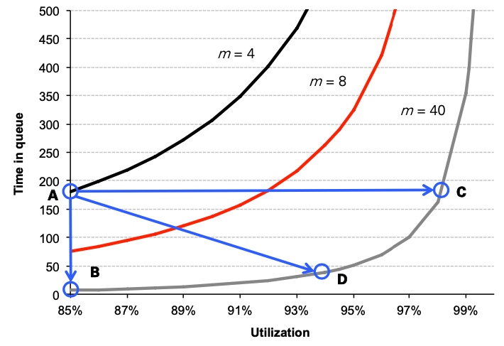
Mix – 0.12
Economies of Scale
Back to the board

Slide 49
Mix – 0.15
To determine how much you are willing to pay for the perfect demand information, compute ______________
1:00
Answer:
0:59
0:58
0:57
0:56
0:55
0:54
0:53
0:52
0:51
0:50
0:49
0:48
0:47
0:46
0:45
0:44
0:43
0:42
0:41
0:40
0:39
0:38
0:37
0:36
0:35
0:34
0:33
0:32
0:31
0:30
0:29
0:28
0:27
0:26
0:25
0:24
0:23
0:22
0:21
0:20
0:19
0:18
0:17
0:16
0:15
0:14
0:13
0:12
0:11
0:10
0:09
0:08
0:07
0:06
0:05
0:04
0:03
0:02
0:01
End
0:30

Slide 50
Mix – 0.15
EVPI
= expected value of perfect information
(Recall the fortune teller story when we discussed Obermeyer?)
Back to the board

Slide 51
Mix – 0.17
σ x I(z) + μ – Q
is the expectation of
______________
Answer:
0:59
0:58
0:57
0:56
0:55
0:54
0:53
0:52
0:51
0:50
0:49
0:48
0:47
0:46
0:45
0:44
0:43
0:42
0:41
0:40
0:39
0:38
0:37
0:36
0:35
0:34
0:33
0:32
0:31
0:30
0:29
0:28
0:27
0:26
0:25
0:24
0:23
0:22
0:21
0:20
0:19
0:18
0:17
0:16
0:15
0:14
0:13
0:12
0:11
0:10
0:09
0:08
0:07
0:06
0:05
0:04
0:03
0:02
0:01
End
1:00
1:00

Slide 52
Mix – 0.17
Lost Sales
σ x I(z) + μ – Q
Quantity - E[leftover] = E[sales]
E[demand] - E[sales] = E[lost sales]
E[leftover]
Order quantity
E[demand]
Back to the board

